Slide 1
Colorizing Monochromatic Images Using Deep Learning
Under guidance of
Ms. P. Swapna
Assistant Professor
Batch No:18
A.Akshitha – 21N31A6601
B.Nirmala Bai – 21N31A6622
Ch.Harshini -21N31A6639

Slide 2
ABSTRACT:
Colorization of grayscale images has become a more researched area in the recent years.
A pragmatic approach to the task is to implement sophisticated image colorization techniques.
We Implement colorization using different CNN models and provide their quantitative and qualitative comparison for colorization.
Here different metrics for color image quality assessments are used. So, here we use LAB color space we L is input data and A, B are target data.
We use pretrained Caffe model to colorize the data.
By this process we don’t lose the quality of grayscale images.

Slide 3
INTRODUCTION:
Colorization, the process of adding color to monochrome images has long been recognized as highly laborious and tedious.
Hence efforts to colorize old B&W images started taking place to give the image a different perspective and a beautiful insight into the captured moments...
With advancement in technology and extensive research in the field of deep learning, models can be trained to learn the knowledge and then apply it to colorize old photographs.
By experimenting with different techniques and refining them, you can effectively add depth and realism to historical photos or create unique, artistic works.

Slide 4
EXISTING SYSTEM:
Existing systems for colorizing black and white images range from traditional manual methods and rule-based approaches to deep learning-based techniques.
Manual colorization, though accurate, is time-consuming and requires expertise.
Rule-based and example-based methods often produce unnatural results due to their reliance on predefined rules or closely matching reference images.
LIMITATIONS:
The layers does not determine accurate colour and brightness.
The main drawback in existing system is it can’t be used for complex things due to restricted data.
For historical photos, getting accurate colors can be difficult without historical references.

Slide 5
PROPOSED SYSTEM:
Here we will be using OpenCV, CNN, pre-trained Caffe model.
The main drawback in existing system is it can’t be used for complex things due to restricted data.
So to overcome this we will be using caffe model and convert the grayscale image to LAB color space then to RGB.
This process is done by converting the input into the desired output.
We use Graphical User Interface by which the user can interact with the system.
And in this we are implementing DeOldify model for colorizing of videos.

Slide 6
ADVANTAGES:
The proposed system for colorizing monochromatic images offers numerous advantages across various fields, from enhancing visual appeal and historical restoration to improving practical applications in medicine and education.
It enhances old movies and photographs, providing a new dimension to historical footage and making it more appealing to modern audiences.
By leveraging AI and deep learning technologies, this system can achieve high levels of accuracy and efficiency, ultimately providing significant value in both creative and analytical domains.

Slide 7
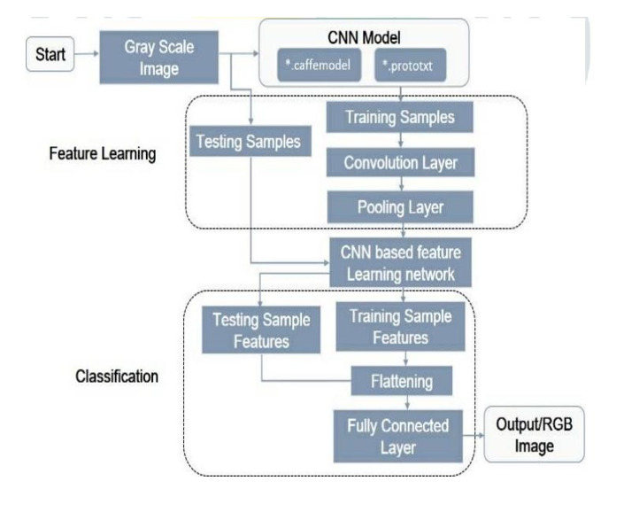
SYSTEM ARCHITECTURE:

Slide 8
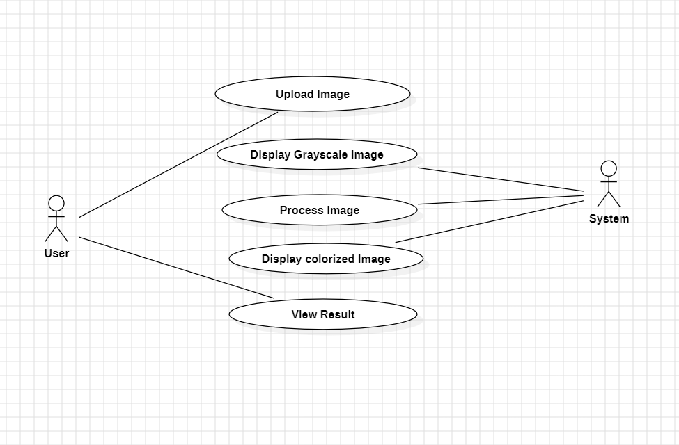
UML DIAGRAMS: USE DIAGRAM:

Slide 9
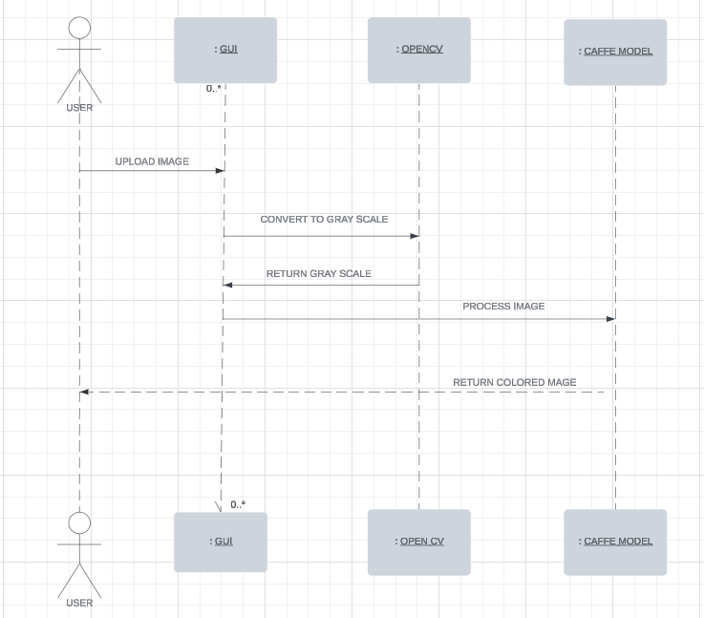
SEQUENCE DIAGRAM:

Slide 10
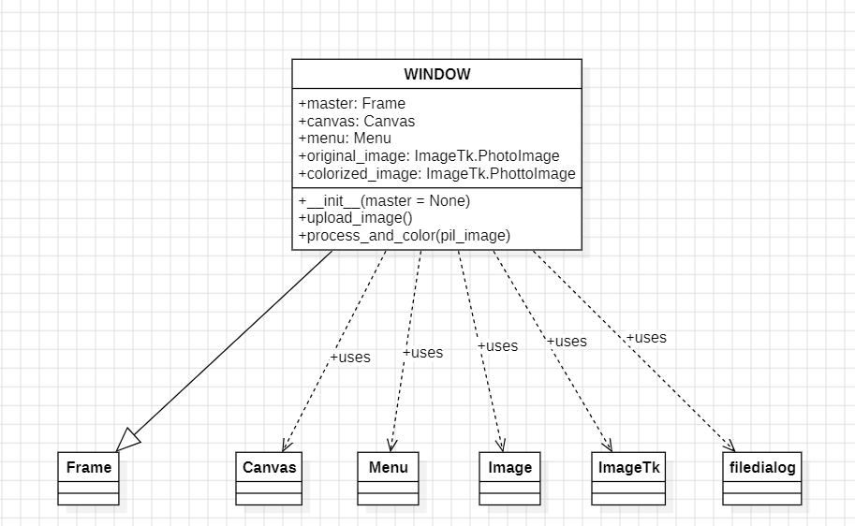
CLASS DIAGRAM:

Slide 11
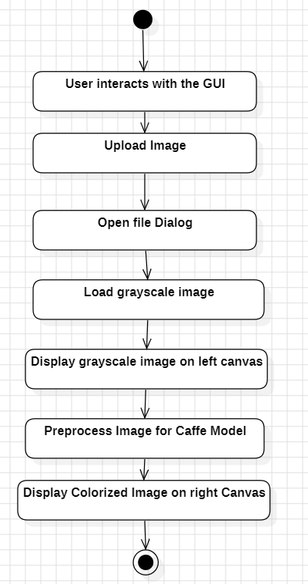
ACTIVITY DIAGRAM:

Slide 12

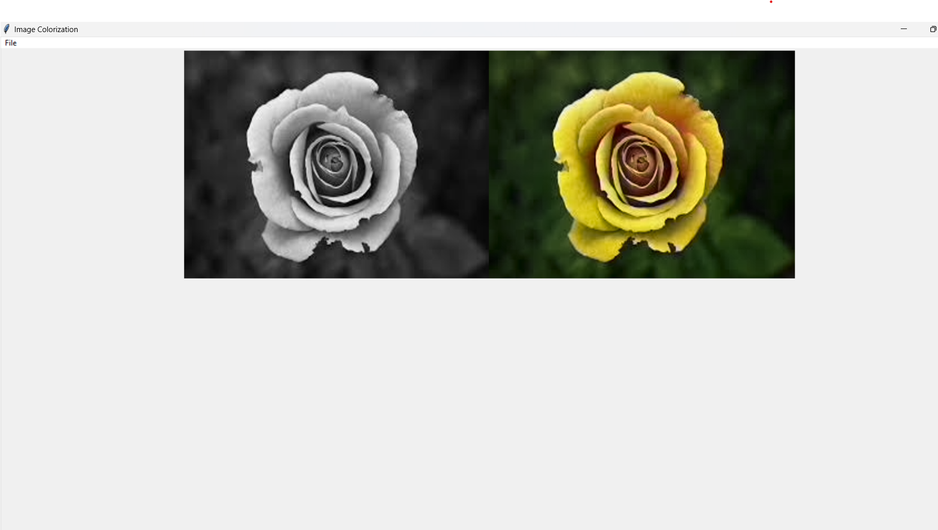
OUTPUT SCREENS: OUTPUT 1:

Slide 13
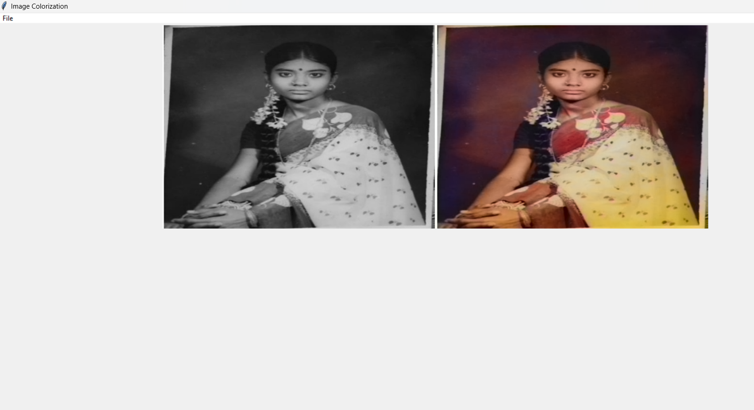
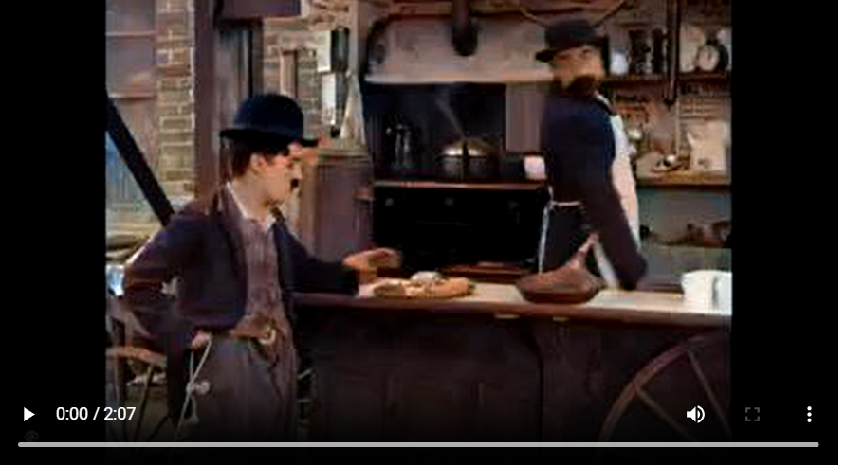
OUTPUT 2 : OUTPUT 3:

Slide 14
SYSTEM REQUIREMENTS:
HARDWARE REQUIREMENTS:
SOFTWARE REQUIREMENTS:
Processor : Intel i7
RAM : 8 GB
Hard disk : 256 GB
Speed : 2.7 GHZ
Operating System :Windows 7 or more
PYCHARM
Graphical User Interface
BACK END: Python

Slide 15
REFERENCES:
https://analyticsindiamag.com/how-to-colorize-your-old-image-using-deoldify/
https://emilwallner.medium.com/colorize-b-w-photos-with-a-100-line-neural-network-53d9b4449f8d
https://medium.datadriveninvestor.com/coloring-black-white-images-using-deep-learning-984e6f4ddf14
https://www.geeksforgeeks.org/colorize-images-using-deoldify/

Slide 16
CONCLUSION:
The project on colorizing black and white images highlights significant advancements in transforming grayscale photos into vivid color.
Even DeOldify colorizes black and white videos by applying deep learning algorithms frame by frame to create vibrant and accurate colors.
Deep learning techniques, such as CNNs and GANs, have proven effective in producing realistic and high-quality colorizations.
These methods enhance the visual appeal and historical context of images, making them a valuable tool for both preserving and interpreting photographic history.
As technology continues to advance, colorization techniques are expected to become even more refined and accessible.

Slide 17
THANK YOU

